Slide 1
CHATBOT APPLICATION

Slide 2
INTRODUCTION:
A chatbot is a piece of technology that allows a computer program to communicate with people just like conversing through text messaging using a natural language, say English, to accomplish specific tasks. A chatbot is also known as an artificial conversational entity (ACE), chat robot, talk bot, chatterbot or chatterbox.
It was a simple program designed to impersonate a psychotherapist and give out predefined responses to user queries. However, the code base was exhaustive enough to take into account several possible queries and the chatbot was capable of passing the Turing Test, a test designed to check out whether a computer program could pass as an actual human being or not. Chatbots today, have become a lot more advanced since then, able to answer substantially complex queries and have expanded capabilities such as voice interaction and machine learning. Some of the technologies employed by chatbots are: Text To Speech – A text-to-speech technology is simply one that converts verbal speech to text on a digital page. That’s its full function, but it’s not one that is simple to design. All the text-to-speech technology does is transcribes verbal speech. The chatbot, on the other hand, will take speech in whichever form it’s made for, understand it, and provide responses that seek to pass the turing test – the test of whether a technology can fool a human into thinking that he or she is speaking with another person.
Chatbots greatly help in reducing the valuable time of your customer care personnel by taking care of routine queries. It then transfers the control of communication over to the organization’s representative after the requirements of the customer have been established. Some chatbots are also equipped to give funny and witty replies to certain questions asked as an additional amusement factor. Others give you information on the film industry, music and other forms of entertainment. People are extremely curious about chatbots by nature. The possibilities are endless and people tinker with the technology in order to expand its scope and capabilities.

Slide 3
ABSTRACT:
ChatterBot is a Python library that makes it easy to generate automated responses to a user’s input. ChatterBot uses a selection of machine learning algorithms to produce different types of responses. This makes it easy for developers to create chat bots and automate conversations with users.

Slide 4
EXISTING SYSTEM:
In existing systems, lack of ability to effectively manage data makes it very difficult. In existing systems they maintained some specific time only, like call centers. It will available only some specific times. Sometimes the user may not get the accurate information from the systems.
Disadvantages of Existing System:
Accuracy is less.
Data management is difficult.

Slide 5
PROPOSED SYSTEM:
In this paper, we propose an automated chat robot design to answer users frequently asked questions, earlier natural language processing techniques were using to design this robots but its accuracy of giving correct answer was less and now due to Deep Learning algorithms accuracy of giving correct answer increase, so here using python deep learning project we are building CHATBOT application to answer users questions.
Advantages:
1. Accuracy is more.
2. It can available at any time.
3. User friendly nature.

Slide 6
SYSTEM REQUIREMENTS
HARDWARE REQUIREMENTS:
Processor - Intel i3 or i4
Speed - 1.1 GHz
RAM - 4 GB (min)
Hard Disk - 500 GB (min)
SOFTWARE REQUIREMENTS:
Operating System - Windows 10 or above
Programming Language - Python (3.7.0)

Slide 7
SYSTEM DESIGN Class Diagram:

Slide 8
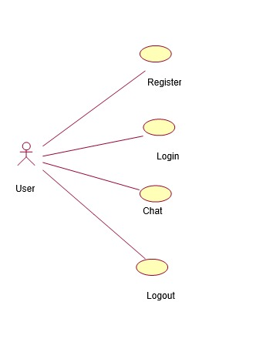
Use case Diagram:

Slide 9
Sequence diagram:

Slide 10
Collaboration Diagram:

Slide 11
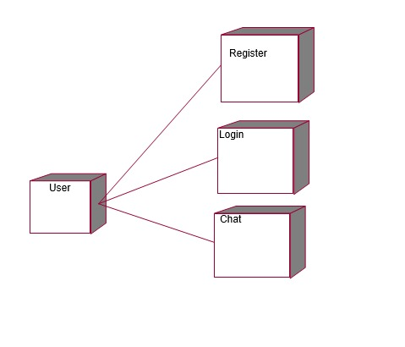
Deployment Diagram:

Slide 12
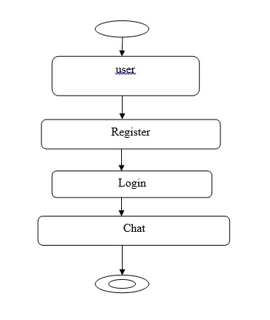
Activity Diagram:

Slide 13
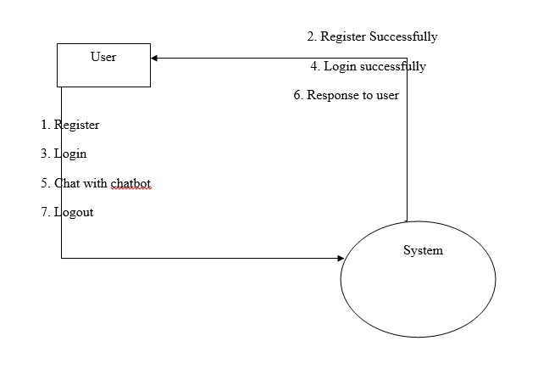
Data Flow Diagram:

Slide 14
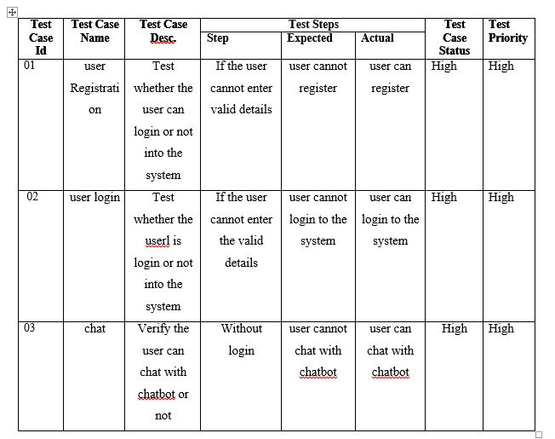
Test Cases

Slide 15
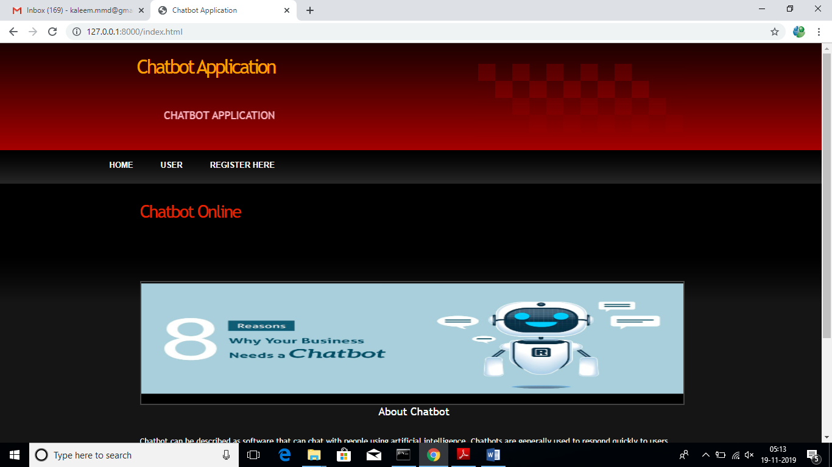
SCREENSHOTS:

Slide 16
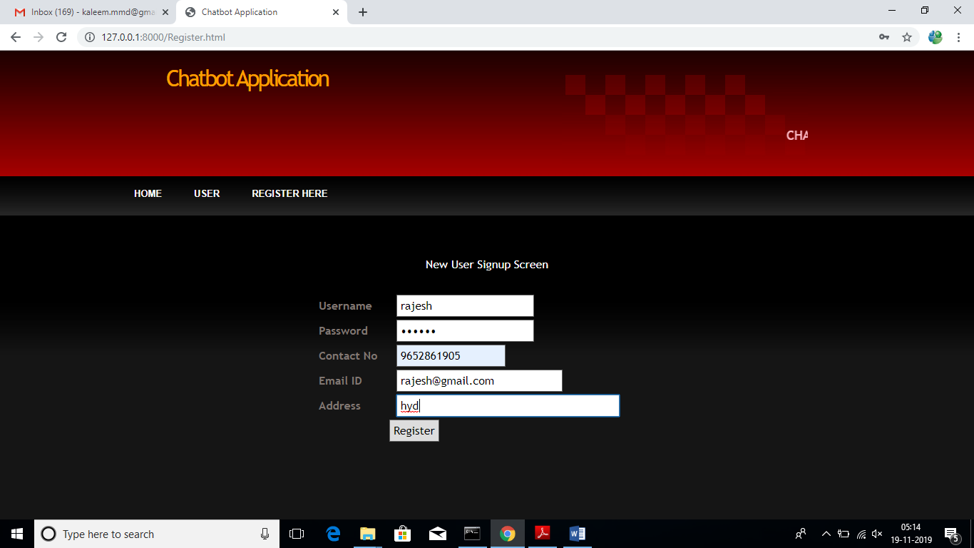
In above screen click on ‘Register Here’ link to add sign up with application

Slide 17
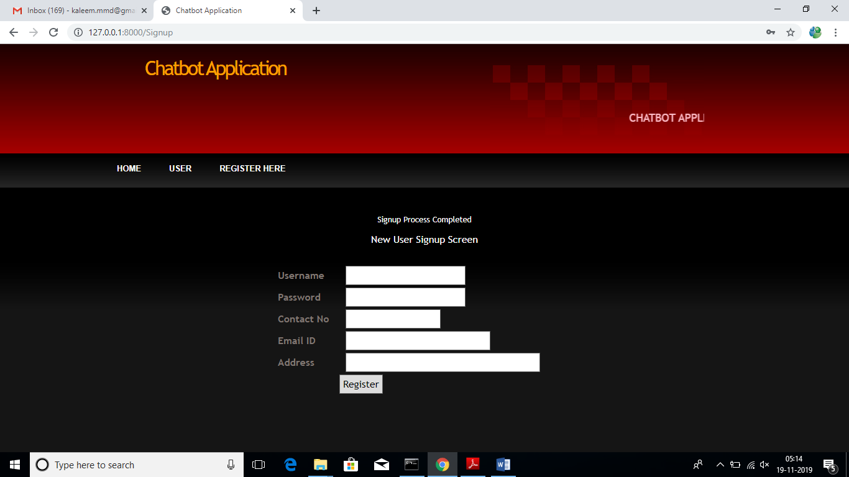
After signup will get below confirmation screen

Slide 18
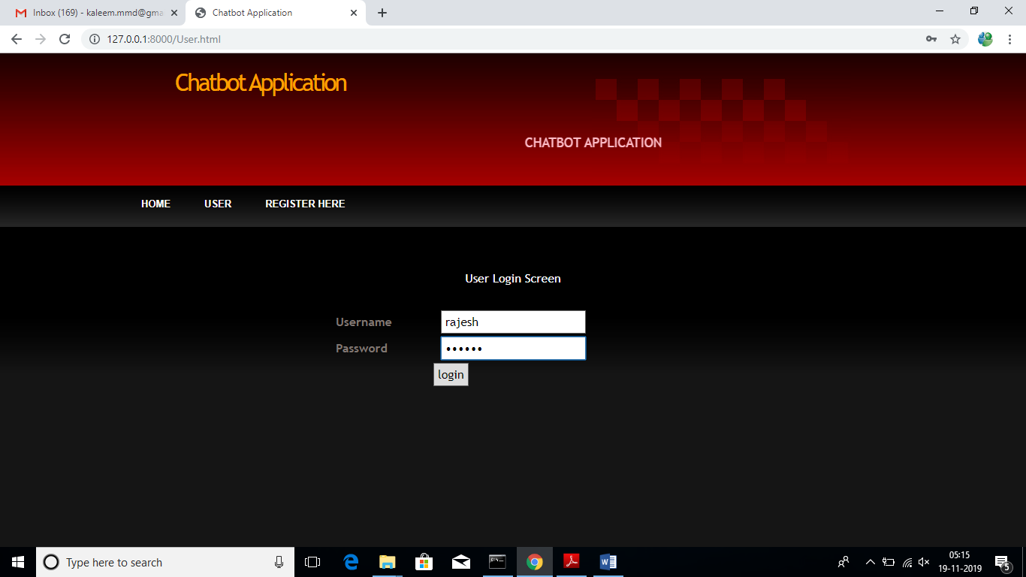
Now click on ‘User’ link to login to application

Slide 19
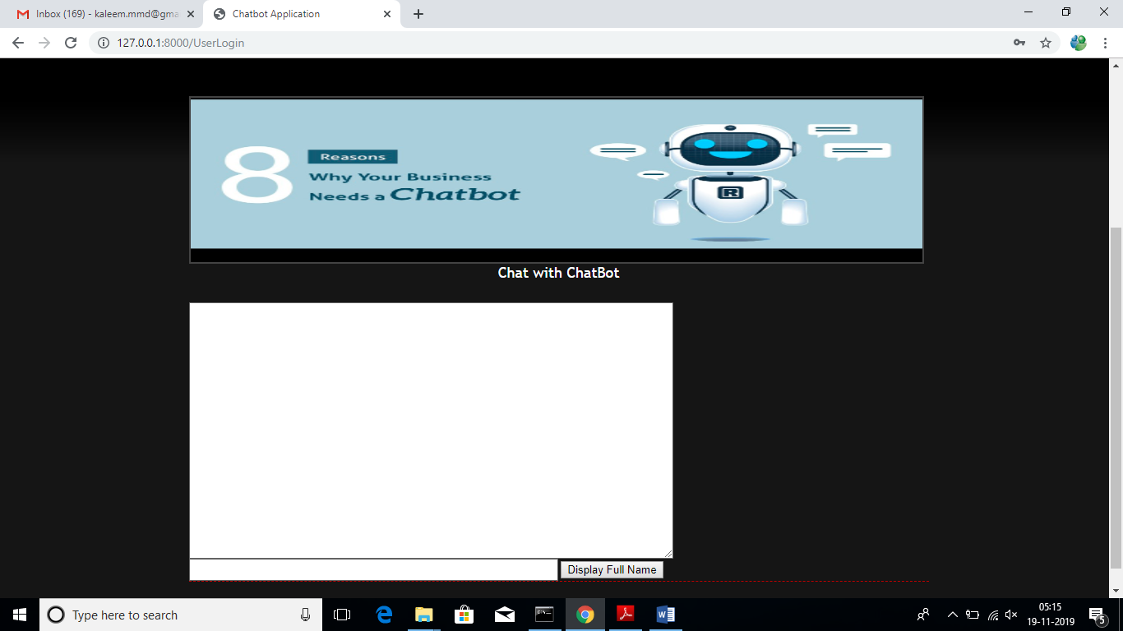
After login will get below user chat bot screen

Slide 20
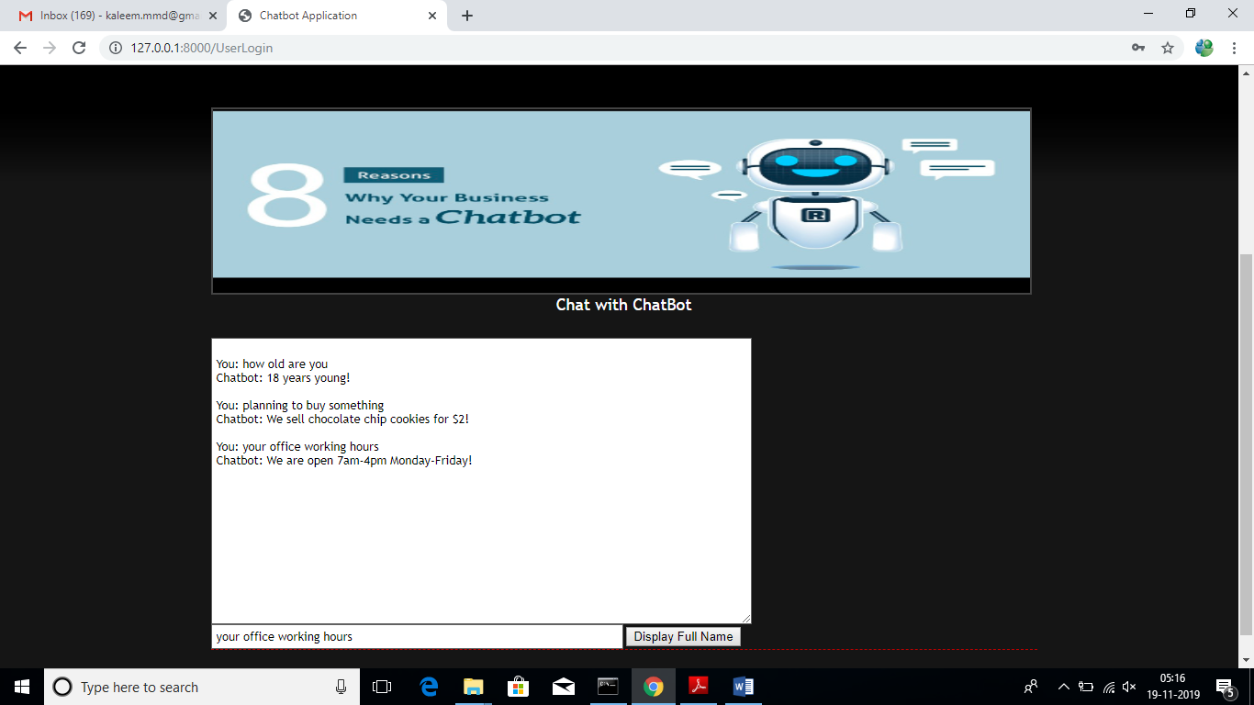
In above screen user can enter questions and chat bot replies to that questions. See below screen

Slide 21
In above screen we can see I asked 3 questions and chat bot answer them correctly. Similarly we can ask any question and chat bot can answers those questions as long as those question answers are available inside training model of deep learning object.

Slide 22
CONCLUSION:
In this paper, we designed a chatbot. A chatbot is a piece of software that conducts a conversation via auditory or textual methods. Chatbots are typically used in dialog systems for various practical purposes including customer service or information acquisition. Some chatbots use sophisticated natural language processing systems, but many simpler ones scan for keywords within the input, then pull a reply with the most matching keywords, or the most similar wording pattern, from a database.

Slide 23
REFERENCES:
[1] Anon, (2016). [online] Available at: https://www.chatbots.org/ai_zone/ [Accessed 11 Dec. 2016].
[2] Foundation, A. (2016). AIML - The Artificial Intelligence Markup Language. [online] Alicebot.org. Available at: http://www.alicebot.org/aiml.html [Accessed 11 Dec. 2016].
[3] Pandorabots.com. (2016). The Slashdot Interview. [online] Available at: http://www.pandorabots.com/pandora/pics/wallaceaimltutorial.html [Accessed 11 Dec. 2016].
[4] Pandorabots.com. (2016). The Slashdot Interview. [online] Available at: http://www.pandorabots.com/pandora/pics/wallaceaimltutorial.html [Accessed 11 Dec. 2016].
[5] Pandorabots.com. (2016). The Slashdot Interview. [online] Available at: http://www.pandorabots.com/pandora/pics/wallaceaimltutorial.html [Accessed 11 Dec. 2016].
[6] Code.msdn.microsoft.com. (2017). Image Caption Bot using Microsoft Bot Framework and Cognitive Services [C#] in C# for Visual Studio 2015. [online] Available at: https://code.msdn.microsoft.com/Image-Caption-Bot-using-61974c49 [Accessed 1 April 2017].
[7] Code.msdn.microsoft.com. (2017). Image Caption Bot using Microsoft Bot Framework and Cognitive Services [C#] in C# for Visual Studio 2015. [online] Available at: https://code.msdn.microsoft.com/Image-Caption-Bot-using-61974c49 [Accessed 1 April 2017].
[8] Hargan, J. and Hargan, J. (2017). The Death of the SMS?. [online] KillBiller. Available at: http://www.killbiller.com/blog/the-decline-of-the-sms [Accessed 4 May 2017].
[9] Code.msdn.microsoft.com. (2017). Image Caption Bot using Microsoft Bot Framework and Cognitive Services [C#] in C# for Visual Studio 2015. [online] Available at: https://code.msdn.microsoft.com/Image-Caption-Bot-using-61974c49 [Accessed 1 April 2017].

